Slide 1
Mathematical Preliminaries and Notation
Ms.M.Prathilothamai,
Assistant Professor,
Department of Computer Science and Engineering,
ASE, Coimbatore.

Slide 2


Sets
A set is a collection of elements, without any structure other than membership
x is an element of the set S: x ∈ S.
x is not in S : x ∉ S.
A set can be specified by enclosing some description of its elements in curly braces
S = {0, 1, 2}.
S = {a, b,…, z}
S =

Slide 3
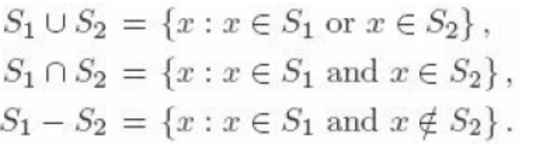

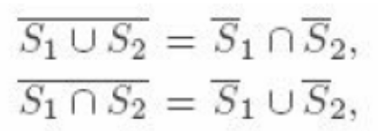
Set Operations and Set Types
Union
Interaction
Difference
Complementation
Demorgan’s law
S1={1,2,3} S2={2,4,6} Ս={1,2,3,4,5,6}
S1ՍS2={1,2,3,4,6} S1-S2={4,6}
S1ՈS2={2} Complement of S1={4,5,6}

Slide 4
Set Types
Empty set/null set
Universal set
Singleton set
Subset: A set S1 is said to be a subset of S if every element of S1 is also an element of S. S1 ⊆ S.
Proper Subset: If S1 ⊆ S, but S contains an element not in S1, we say that S1 is a proper subset of S. S1 ⊂ S.

Slide 5

Set Types
Power set S={a, b, c}
  Set of all subsets of a set S : power set
  Size of the powerset
Disjoint set: set with no common elements
Infinite set: set with infinite number of elements
Finite set : set with finite number of elements

Slide 6
Function
A function is a rule that assigns to elements of one set a unique element of another set.
If f denotes first set is called the domain of f, and the second set is its range.
write f : S1 → S2
to indicate that the domain of f is a subset of S1 and that the range of f is a subset of S2.
If the domain of f is all of S1, we say that f is a total function on S1; otherwise f is said to be a partial function.

Slide 7
Example
f : n → 2^{n}
1 2 1 a
2 4 2 b
3 8 3 c
4 d
Partial Function
Not a function
One to Many x
Relation-

Slide 8
Conti…
1 3 1 a
2 5 2 b
3 7 3 c
        8
Total Function Function
f: x→2x+1

Slide 9
Graph
A graph is a construct consisting of two finite sets, the set V = {υ1, υ2,…, υn} of vertices and the set E = {e1, e2,…, em} of edges.
Each edge is a pair of vertices from V
for instance, is an edge from υj to υk.
The edge ei is an outgoing edge for υj and an incoming edge for υk :a directed graph (digraph).

Slide 10
Conti…
Graphs may be labeled, a label being a name or other information associated with parts of the graph. Both vertices and edges may be labeled.
Graphs are conveniently visualized by diagrams in which the vertices are represented as circles and the edges as lines with arrows connecting the vertices.

Slide 11
Example
The graph with vertices {υ1, υ2, υ3} and edges {(υ1, υ3), (υ3, υ1), (υ3, υ2), (υ3, υ3)} is depicted in Figure 1.
A sequence of edges (υi, υj), (υj, υk),…, (υm, υn) is said to be a walk from υi to υn.
V1
V2
V3

Slide 12
Conti…
The length of a walk is the total number of edges traversed in going from the initial vertex to the final one.
A walk in which no edge is repeated is said to be a path; a path is simple if no vertex is repeated.
A walk from υi to itself with no repeated edges is called a cycle

Slide 13
Thank You

